Slide 1
Hyperloop Inventory Exchange Network
CONCEPT BRIEF
Turning returned products into forward inventory, not reverse cargo.
Returns and reverse-logistics platform concept
Notes:
Opening slide. The core promise: every return is evaluated right where it lands, instead of defaulting to a trip back to the central warehouse.

Slide 2
The problem — and how we solve it
CRITERION 1 · PROBLEM & INDUSTRY RELEVANCE
PROBLEM
OUR SOLUTION
High cost of multiple transport legs per return
→
Evaluate and resell right where the return lands
Minor faults trigger a full trip back to origin
→
Local repair partners fix it on the spot — no long haul
Saleable stock sits idle, unavailable in its own region
→
A demand & climate check reinstates it into local inventory, fast
A local warehouse hits capacity
→
Lowest-demand stock transfers to the nearest high-demand zone

Slide 3
What's genuinely new here
CRITERION 2 · INNOVATION & ORIGINALITY
1
Reason classification — AI tells a hardware defect apart from personal dissatisfaction
2
Geographic demand check — reads local conditions and demand to decide whether to keep the product nearby
3
Service-centre routing — hardware issues go straight to the brand's authorised service centres
4
Warehouse rebalancing — if the local warehouse is full, the product shifts to the nearest one with room

Slide 4
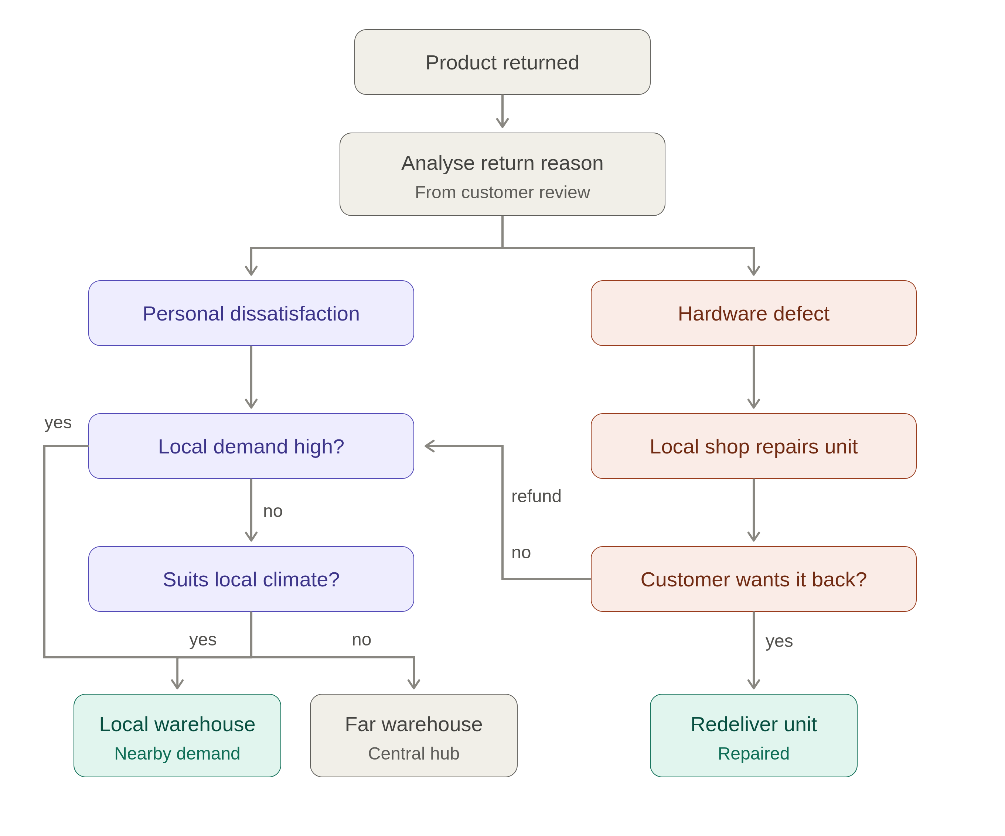
How the system decides, end to end
CRITERION 3 · PROPOSED AI / TECHNICAL APPROACH

Slide 5




Four models power every decision
CRITERION 3 · PROPOSED AI / TECHNICAL APPROACH
NLP classifier
Geographic demand model
Reads the return reason and review text to sort dissatisfaction from defect
Reads pincode-level order history — revealed demand, not a guess
Climate & usage-fit model
Local-first ranking model
Scores environmental fit to seed demand in underserved zones
Re-ranks search results live, surfacing nearby returned stock first

Slide 6
Technical implementation plan
CRITERION 4 · FEASIBILITY & IMPLEMENTATION PLAN
1
Data layer — mock dataset of orders, pincodes, categories and climate zones
2
Classifier service — NLP model tags each return as dissatisfaction or defect
3
Decision engine API — applies the demand and climate-fit rules, routes the item
4
Repair & refund workflow — endpoints simulate the local-repair branch
5
Search re-ranking — boosts local-pool items in storefront search results
6
Demo dashboard — visualises a return moving through the pipeline live
Technical risks, addressed early:
Limited training data
Re-ranking latency
Mock vs. real APIs

Slide 7




What the system buys back
CRITERION 5 · EXPECTED IMPACT
Cost
Speed
Lower reverse-logistics spend
Fewer transport legs per unit
Faster return-to-resale turnaround
Same-day regional availability
Environmental
Commercial
Lower emissions per return
Less repeat packaging waste
Faster-moving discount tier
New repair-partner revenue

Slide 8
Every return becomes a local opportunity.
CLOSING
Next: inter-zone transfers, predictive pre-positioning, and carbon savings shown right at checkout.
Thank you — questions welcome

